Slide 1
ESW Presentation
Topic-Waste Detection and Segregation using Computer Vision Solutions and Algorithms

Slide 2
MID EVALS
Team Name- Sheta Ke Kptaanz
Name of Members-
Ayush Sheta
2. Kavya Bhalodi
3. Shivam Gupta
4. Soham Sadavarte
Professor Name- Sachin Chaudhari
TA – Ansh Shah

Slide 3
TIMELINE WEEK 1-2
3. Training YOLOV8 model
2. Creating Custom DataSet
1. Data Collection

Slide 4
1. Creating a sizeable dataset with different images in various orientations. 2. Annotating and Labeling the images to detect different wastes. 3.
Envisioning and developing the solution to this problem

Slide 5
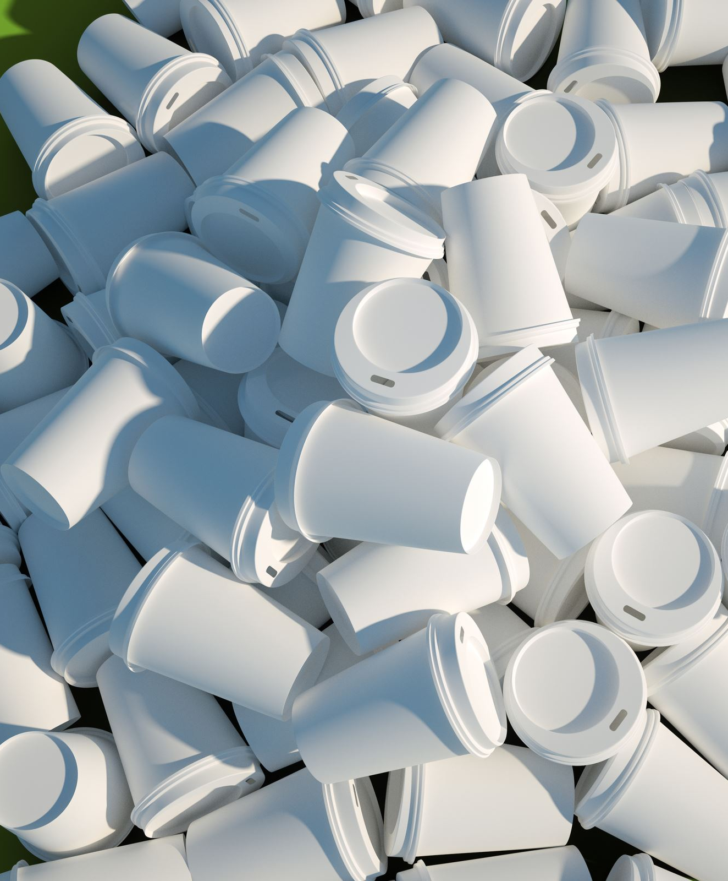
WASTE & DATA COLLECTION
Amount of data collected- Approximately 200-300 images of different types of waste objects were collected thus making the project versatile.
Different Types of Wastes Collected-
1. Plastic Bottles
2. Cardboard
3. Metal Cans
4. Snackbags
5. Paper Waste

Slide 6
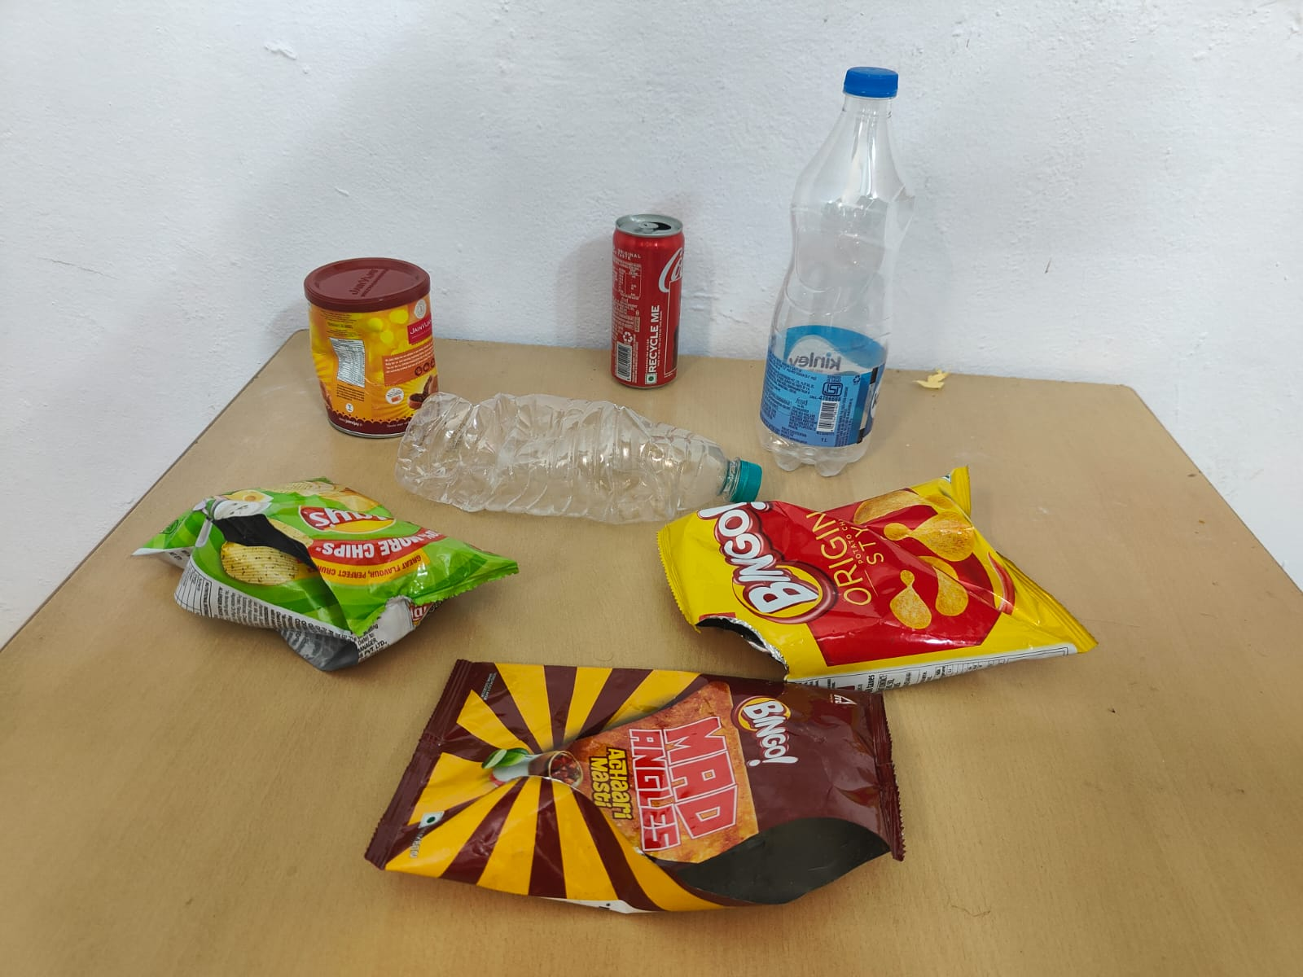
Different types of waste objects in a single frame.

Slide 7
Creating our own dataset
Setting up Roboflow
Researched different compatible and easy-to-operate datasets. Surfed websites like Kaggle, ImageNet, and Roboflow. Finally, decided to create the dataset on Roboflow.
Creating Custom Dataset
Watched relevant YouTube videos on how to set up or initialize the dataset and uploaded stored pictures.
Annotation and Labeling
Applied labels to waste objects, such as giving the label "Plastic Bottle" to various bottles including drinking water bottles, packaged bottles, and crushed or crumbled bottles.
Used layers to cover the waste objects in the image and mapped them to classes corresponding to specific waste types.

Slide 8
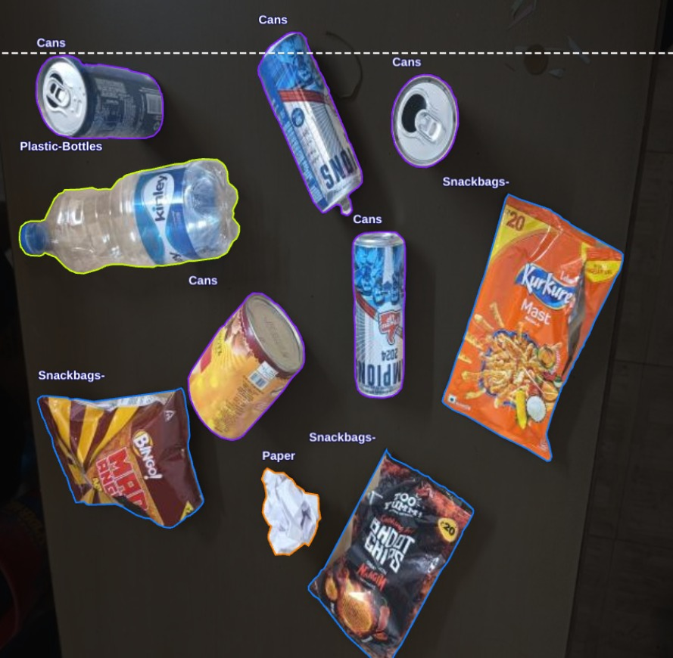
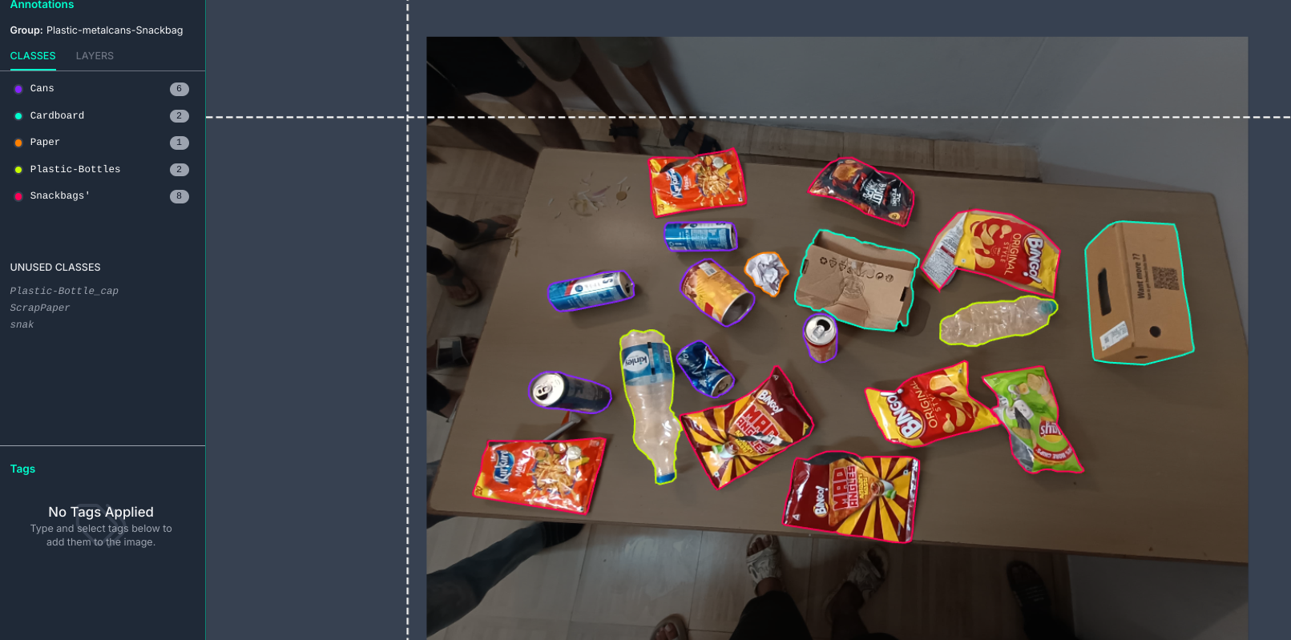
Different wastes annotated in a single frame.

Slide 9
Augmentation & Preprocessing
Preprocessing- Properly orienting the images using auto orient and then resizing stretching the image to 640*640. This is the preprocessing phase.
Augmentation- Performed transitions and transforms to the images already present in the dataset to increase the number of images in dataset. Basically, we have applied the h-v flip operation. This will help us making our model more accurate and precise.

Slide 10
Training & Validating the model
Training Phase- After creating our own custom dataset we have trained the waste detection and segregation model using YOLOV8. After successfully training the model we were able to generate the required files (the .pt files).
Validation- We used the .pt files generated (as mentioned above) to validate our model. We also used YOLOV8 to validate our model.

Slide 11
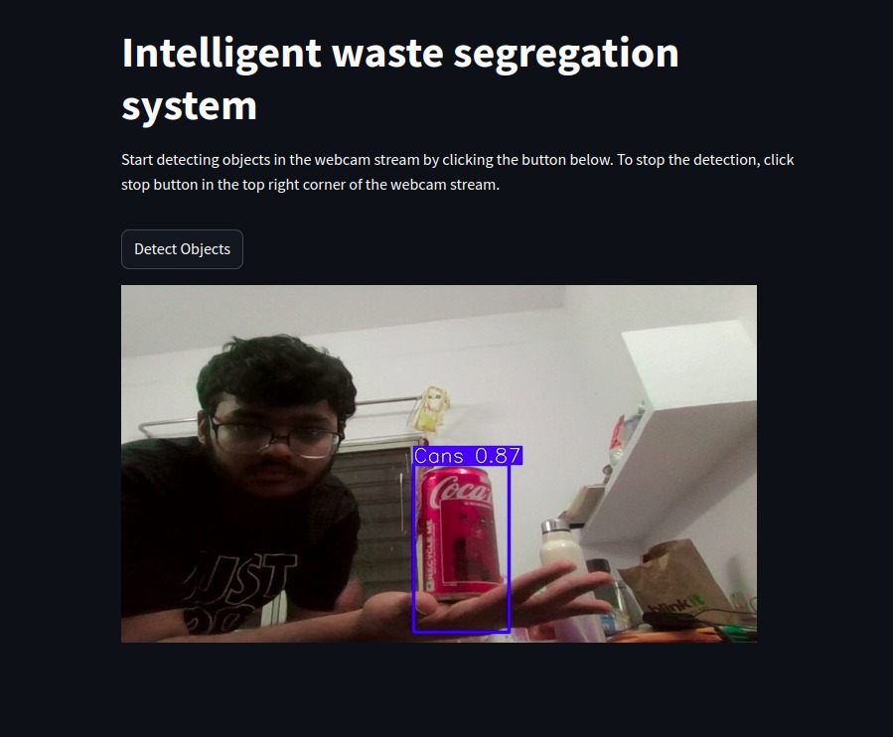
Some insights into the model testing phase

Slide 12
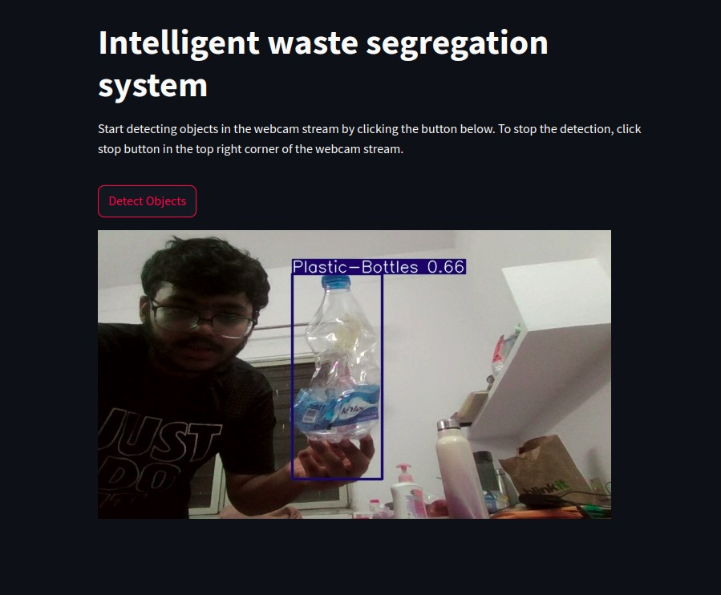
Stress Testing
Testing the accuracy of the model using crumbled plastic bottle. (since actual waste is thrown like that)

Slide 13
Week-3,4 Timeline
• Task-1: Expansion of dataset
• Task2: Uploading and running the model on QIDK kit

Slide 14
DATASET EXPANSION & MODIFICATION
Adding More Images to Dataset: We clicked more and more photos and also uploaded images from internet (ImageNet to be precise).
Annotating the added images: We annotated the added images making the model more accurate and reliable.
Augmentation: Performed transitions and transforms to the images already present in the dataset to increase the number of images in dataset. Basically, we have applied the h-v flip operation.

Slide 15
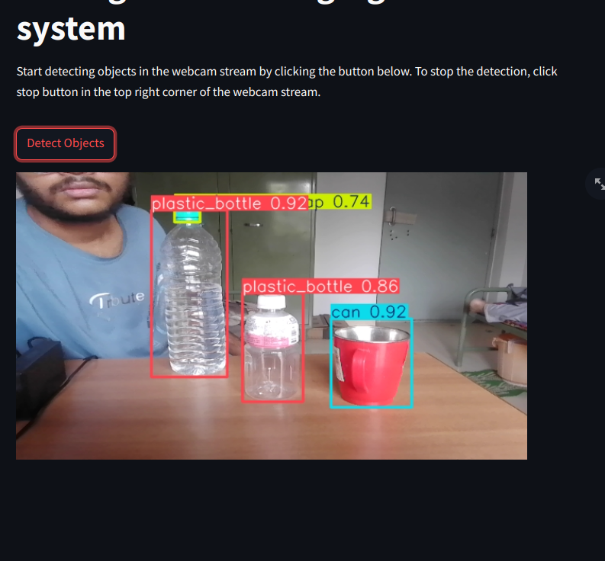
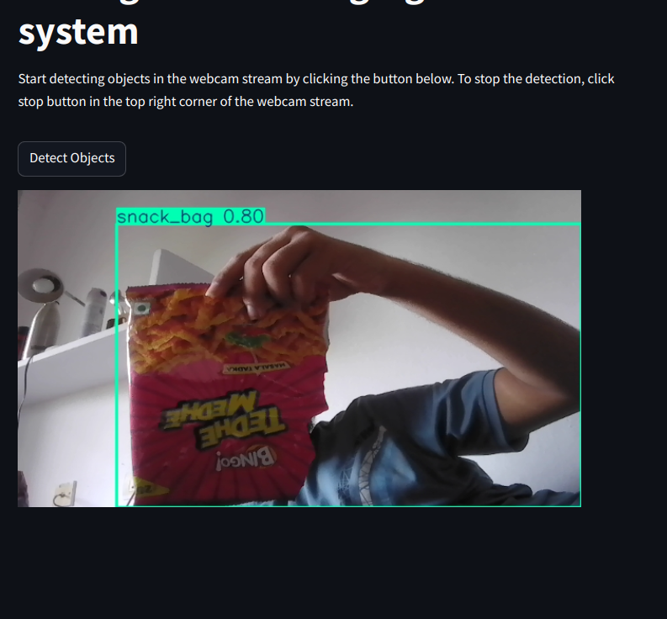
EXAMPLE OF MODEL TESTING

Slide 16

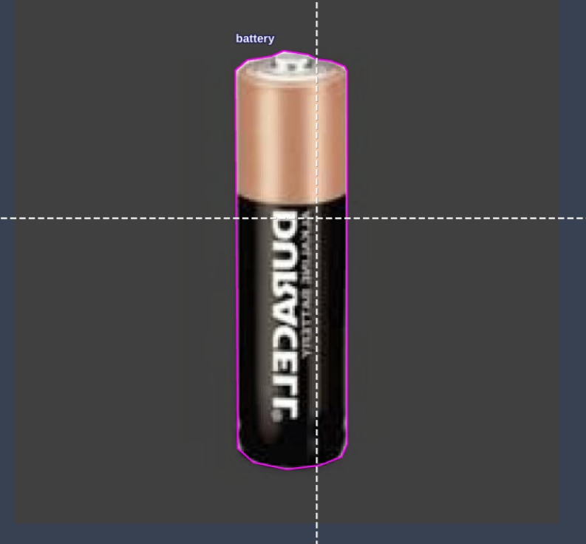
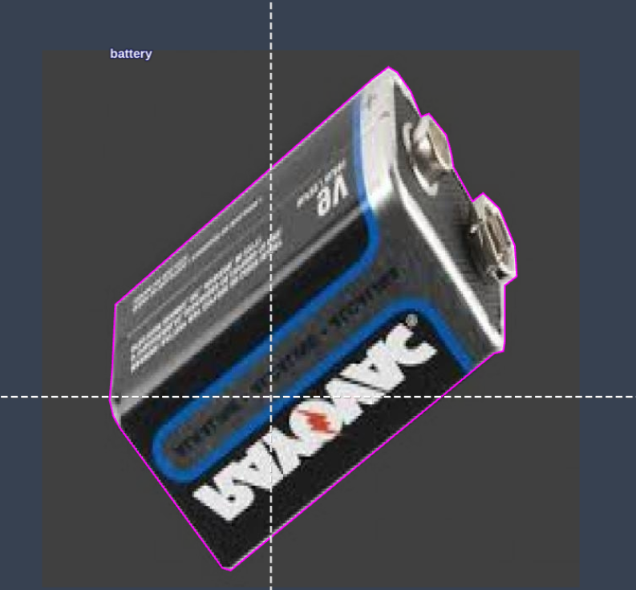
Testing the model
To effectively test the model we implemented the following steps:
1. Waste Collection: We collected different types of wastes and added their images in addition to images of waste articles we already had in our dataset. We even added images of electrical wastes like electrical cells, batteries etc to our dataset so that the model becomes more versatile in detecting waste.
2. Testing the model: We tested our model in various ways. First, we detected solitary waste objects by testing only one object at a time and then successfully examined the scenario where different wastes are present in a single frame.

Slide 17
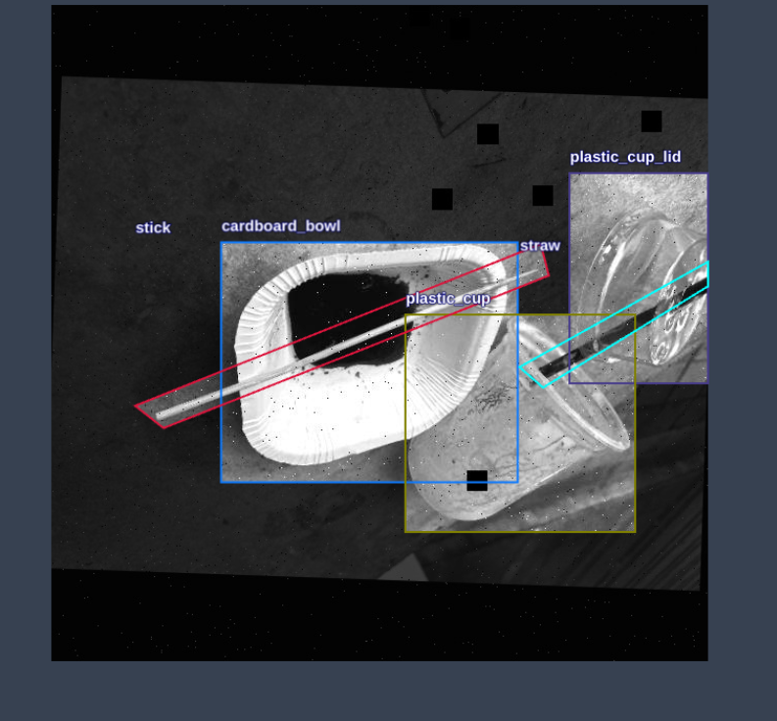
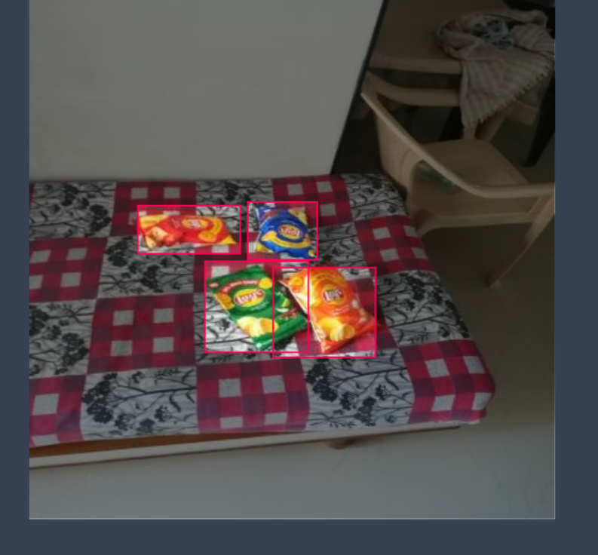
Major updates in model
Added more snackbags
Plates and spoons (disposables)
like in canteens
Batteries and cells
Straws

Slide 18
Model Deployment
Uploading Model to QIDK kit:
We followed the following procedure to upload our model to the QIDK kit (android model) -
1. Environment Setup
Before starting, we ensured that Android Studio was installed on our Linux machine. We downloaded Android Studio from the official website and installed the necessary components, including the SDK. The following configurations were necessary:
Selected Kotlin DSL for Gradle configuration.
Created a new Android project called esw within Android Studio.
Once Android Studio was properly set up, we proceeded to the next steps to integrate the .dlc model.

Slide 19
Model Deployment (contd.)
2. Project Initialization-
After creating the project, we followed these steps:
Created the assets Directory:
In the app/src/main directory, we manually created an assets folder to store our .dlc model file. This directory will later be used to access the model file at runtime.
Uploaded the .dlc Model:
We dragged and dropped the model.dlc file into the assets directory.

Slide 20
Model Deployment (contd.)
3. SDK Integration:
To run the model on the device, we integrated Qualcomm's Neural Processing SDK by adding the following dependency to our build.gradle.kts file (as we are using Kotlin DSL):
Kotlin
dependencies { implementation("com.qualcomm.qti.neuralnetwork:neural-network:1.23.0")
}
We synced the project to ensure that all the dependencies were correctly implemented without errors.

Slide 21
Model Deployment (contd.)
4. Model Loading and Execution
To run the .dlc model, we followed these steps:
ModelRunner Class Creation: We created a new Kotlin class ModelRunner.kt in the com.example.esw package. This class manages model loading, execution, and resource management. The class was designed to load the model from the assets folder, run the model on input data, and then release resources upon completion.

Slide 22
Model Deployment
We also tried to deploy our model using Jupyter notebook when the former method failed (using Android Studio App) to give us the desired results.
For implementing this method we watched the Qualcomm tutorial on how to deploy the YOLO-NAS (closely related to YOLO-V8) model on QIDK kit.

Slide 23
Model Deployment (contd.)
We executed the following steps sequentially:
Model Conversion to ONNX: The PyTorch model was converted to ONNX format, which keeps the model structure intact across different frameworks.
ONNX to DLC Conversion: Using Qualcomm's SNPE tool, the ONNX model was converted to DLC format, optimized for Qualcomm hardware.
Model Quantization: The DLC model was quantized to make it faster and more efficient for use on edge devices, with minimal accuracy loss.

Slide 24
Model Deployment (contd.)
Input Data Preparation: Images were converted into .raw format to be compatible with the QIDK kit for testing.
Deployment on QIDK Kit: The model and input images were uploaded to the QIDK kit, but the model didn’t work as expected during testing.
Troubleshooting: The issue could be due to data compatibility or hardware-specific problems, and further testing is needed to find the solution.

Slide 25
Week-5 Timeline
1. Implementing the hardware architecture to run the model
2. Reviewing the model and striving for potential improvements
3. Uploading the model on QIDK kit via android studio

Slide 26
Weekly Progress Report
Task-1: Hardware Architecture Implementation- Tried to segregate wastes according to classification by using different waste bins with flaps whose opening and closing can be controlled by us to a larger extent.
Task-2 : Reviewing the model for scope of further improvements - Further stress tested the model on a more diverse set of waste items in different orientations. This further helped us to correct our model in case of discrepancies.
Task-3 Uploading the model on QIDK kit-
Trying to integrate our working model on the android system present in the QIDK kit using Android Studio .

Slide 27
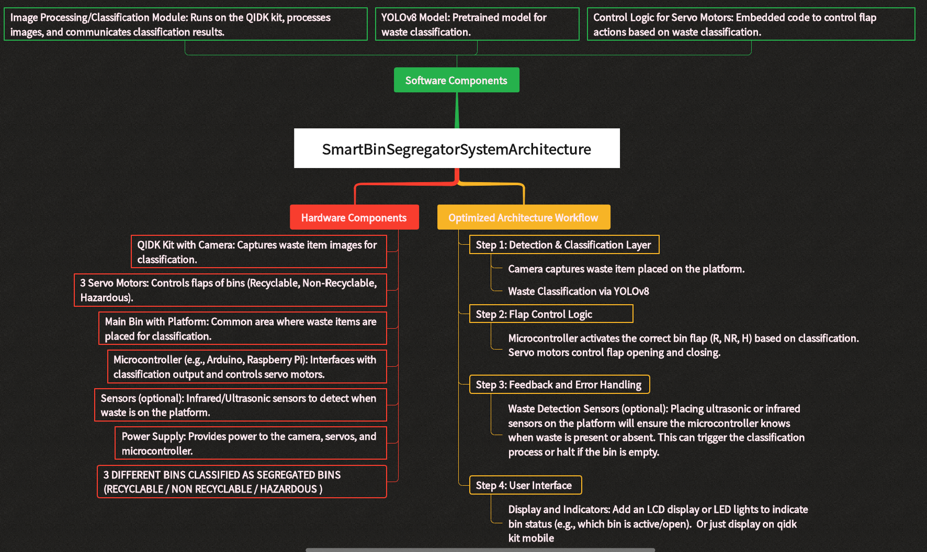

Slide 28
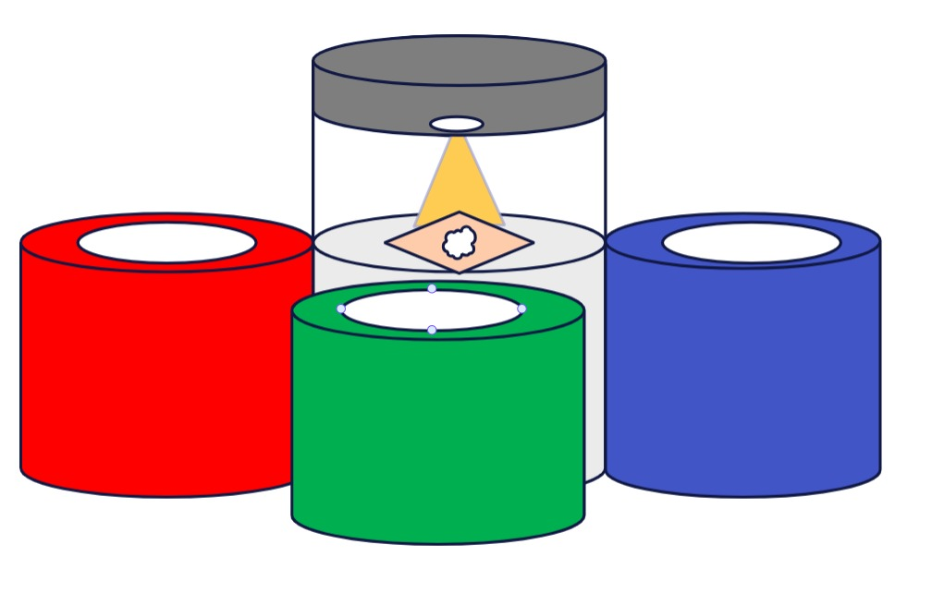
HARDWARE VISION ARCHITECHUTUE
r

Slide 29
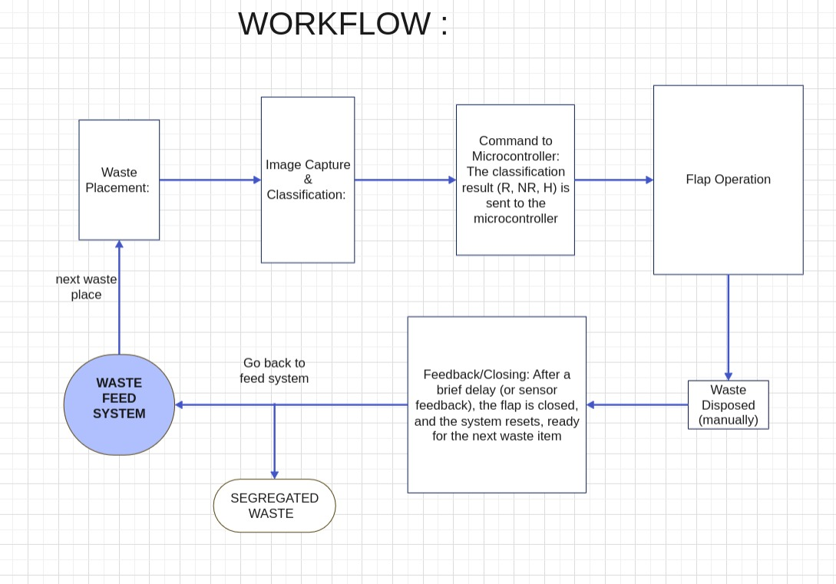

Slide 30
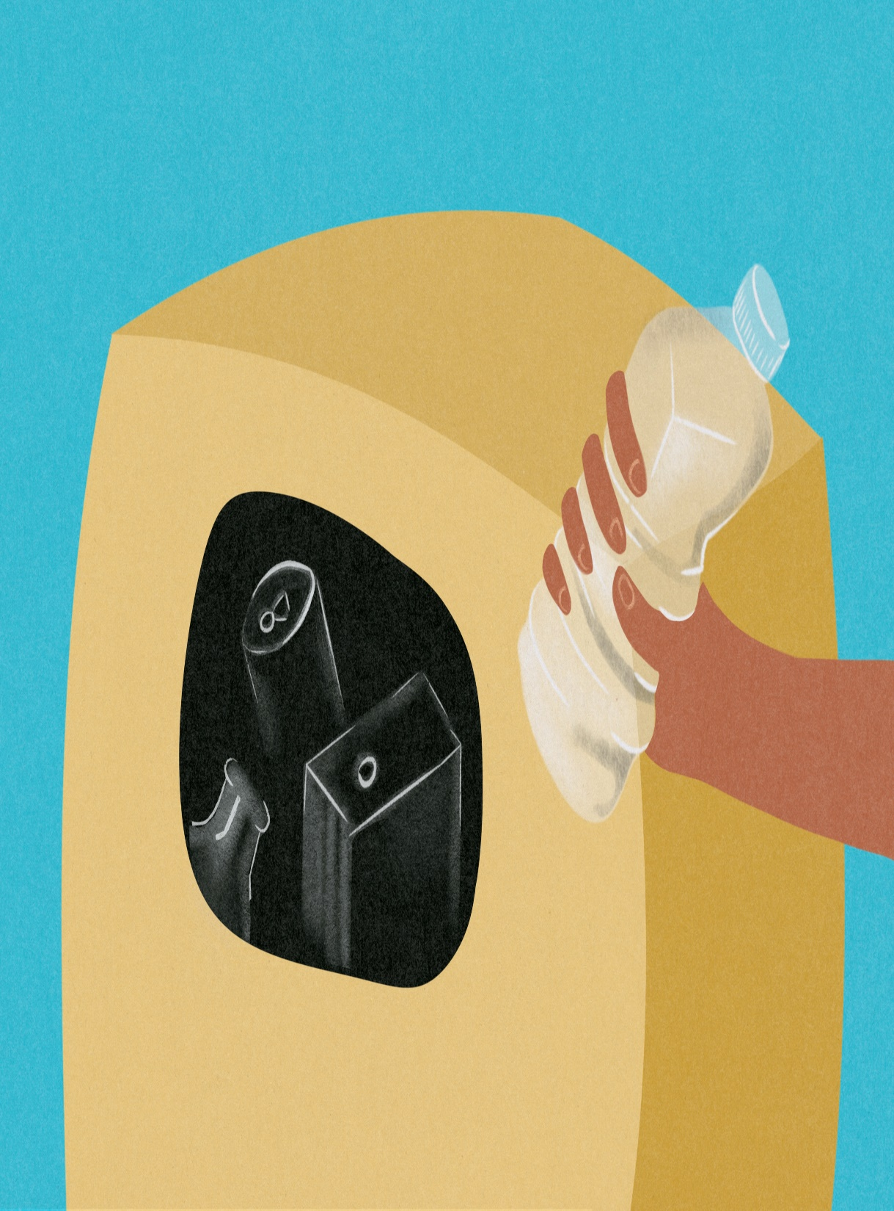
HARDWARE IMPLEMENTATION INTRICACY
The vision and core idea regarding the hardware implementation is summarized in a clear and precise manner in the flowchart given on next slide:
An insight into this leads us to conclusion that certain sensors and actuators are needed to implement the required hardware architecture. The required sensors are listed below:
1. Proximity Sensor
2. IR Sensor
3. Ultrasonic Sensor
4. Servo Motor

Slide 31
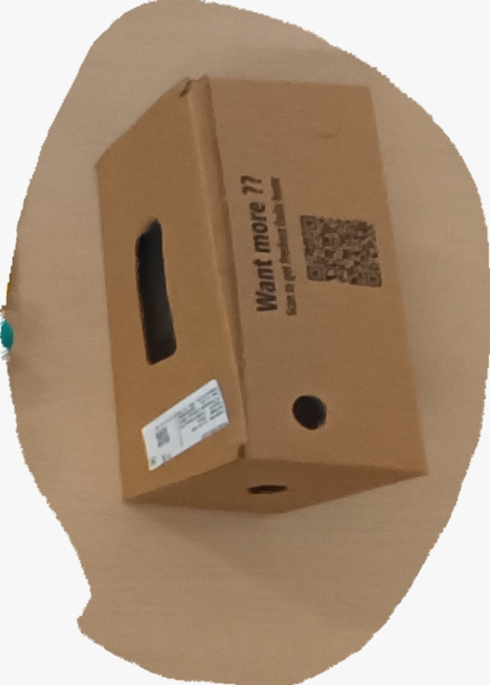
Other important tasks done this week Stress Testing the model- We stress tested our model on a diverse set of waste items comprising of different classes of articles like recyclable, non-recyclable etc and came to the conclusion that the model is precise and accurate.
r

Slide 32
Uploading the model on QIDK kit
We were able to generate the .dlc files from the corresponding .pt files. We also referred to the Vision Solutions when we surfed and examined the QIDK github repository online.
To proceed further we imported the whole abovementioned repository on anroid studio application to generate the .apk flies.
To achieve our task of generating the .apk we followed all the necessary steps described explicitly in the Vision Solutions repository in a sequential manner.

Slide 33
Challenges Encountered and Failures
Gradle Sync Phase- Syncing the gradle package in android studio application is a necessity for successful compilation and loading of our model.
Acknowledgement Failure- Upon syncing the gradle package the successful termination message could not be retrieved thus indicating presence of potential errors in the codebase which are yet to be addressed.

Slide 34
THANK YOU !!!

